Slide 1
We’re separate because...
View in PRESENTATION view to listen to audio with slides
We trust the one in charge. . .

Slide 2
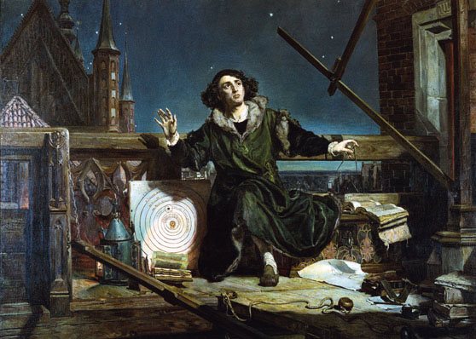
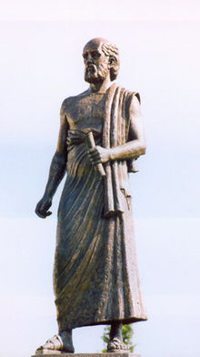
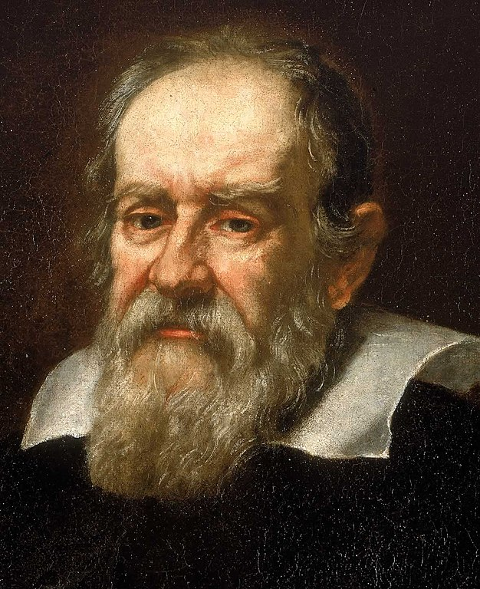
What is at the centre. . .
Aristarchus - 300BC
Galileo – 1564 - 1642
Nicolaus Copernicus – 1473 - 1543

Slide 3
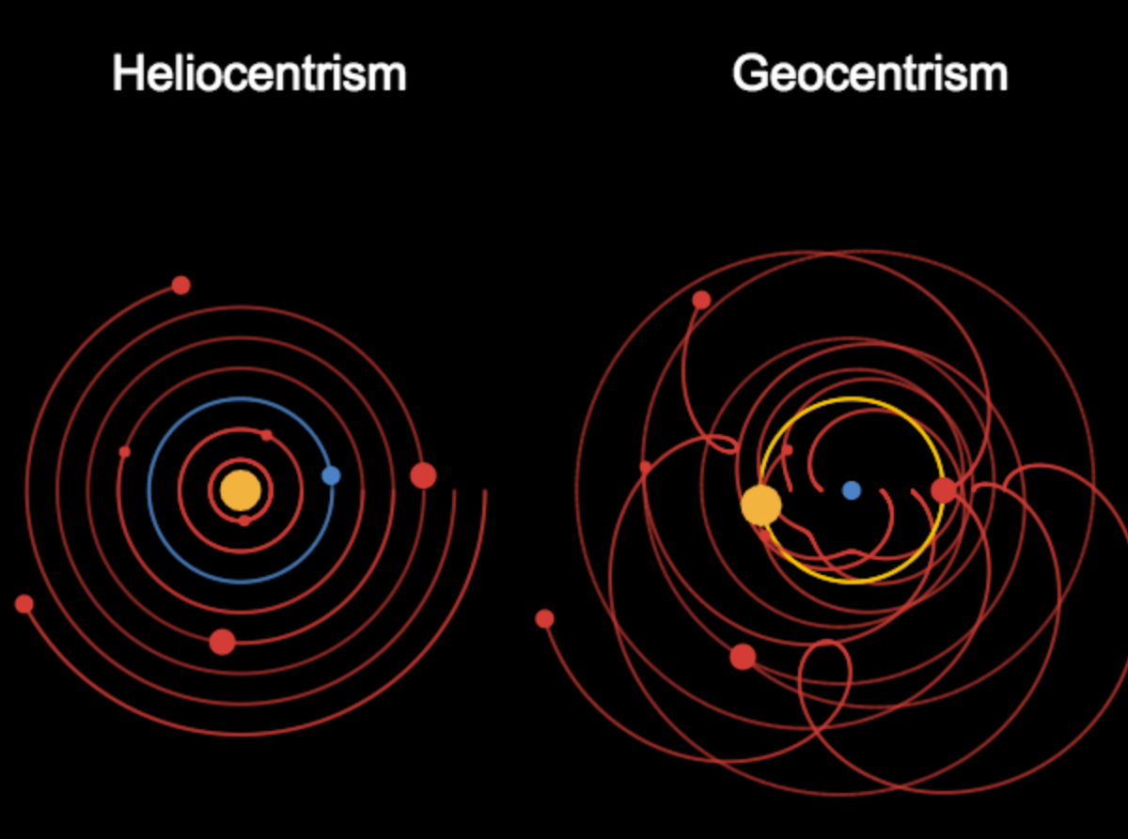
Models of the Solar System. . .
“We pronounce, judge, and declare, that you, the said Galileo… have rendered yourself vehemently suspected by this Holy Office of heresy, that is, of having believed and held the doctrine (which is false and contrary to the Holy and Divine Scriptures) that the sun is the center of the world, and that it does not move from east to west, and that the earth does move, and is not the center of the world.”
(1633)
Notes:
Bible verses about stationary earth:
Psalm104:5 “Who laid the foundations of the earth, that it should not be removed for ever.”
1 Samuel 2:8 ““for the pillars of the earth are the Lord's, and he hath set the world upon them.” KJV
Aristotle – Geocentrism.

Slide 4
Letter to Benedetto Castelli - 1613
. . .it being obvious that two truths can never contradict each other, the task of wise interpreters is to strive to find the true meanings of scriptural passages agreeing with those physical conclusions of which we are already certain and sure from clear sensory experience or from necessary demonstrations. . .
Notes:
Galileo wrote to Benedictine Benedetto Castelli 1613
https://en.wikipedia.org/wiki/Letter_to_Benedetto_Castelli

Slide 5
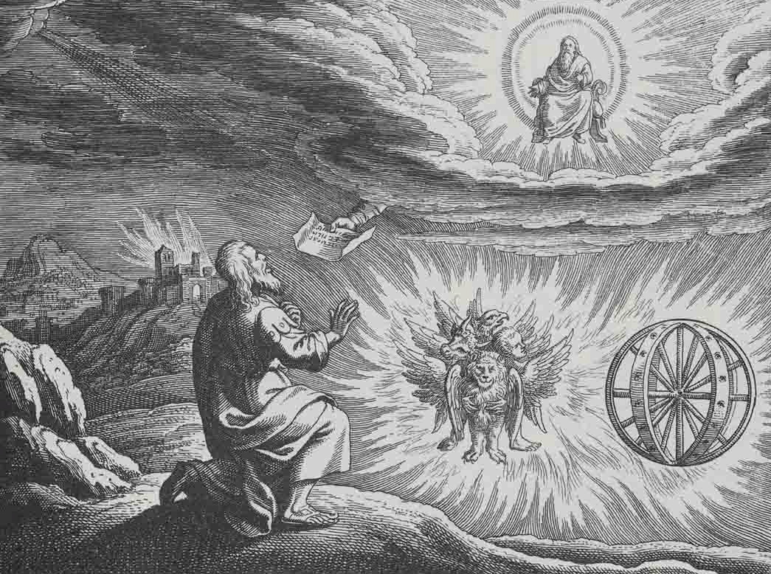
What is at the centre?
Revelation 4 & 5
Ezekiel 1

Slide 6
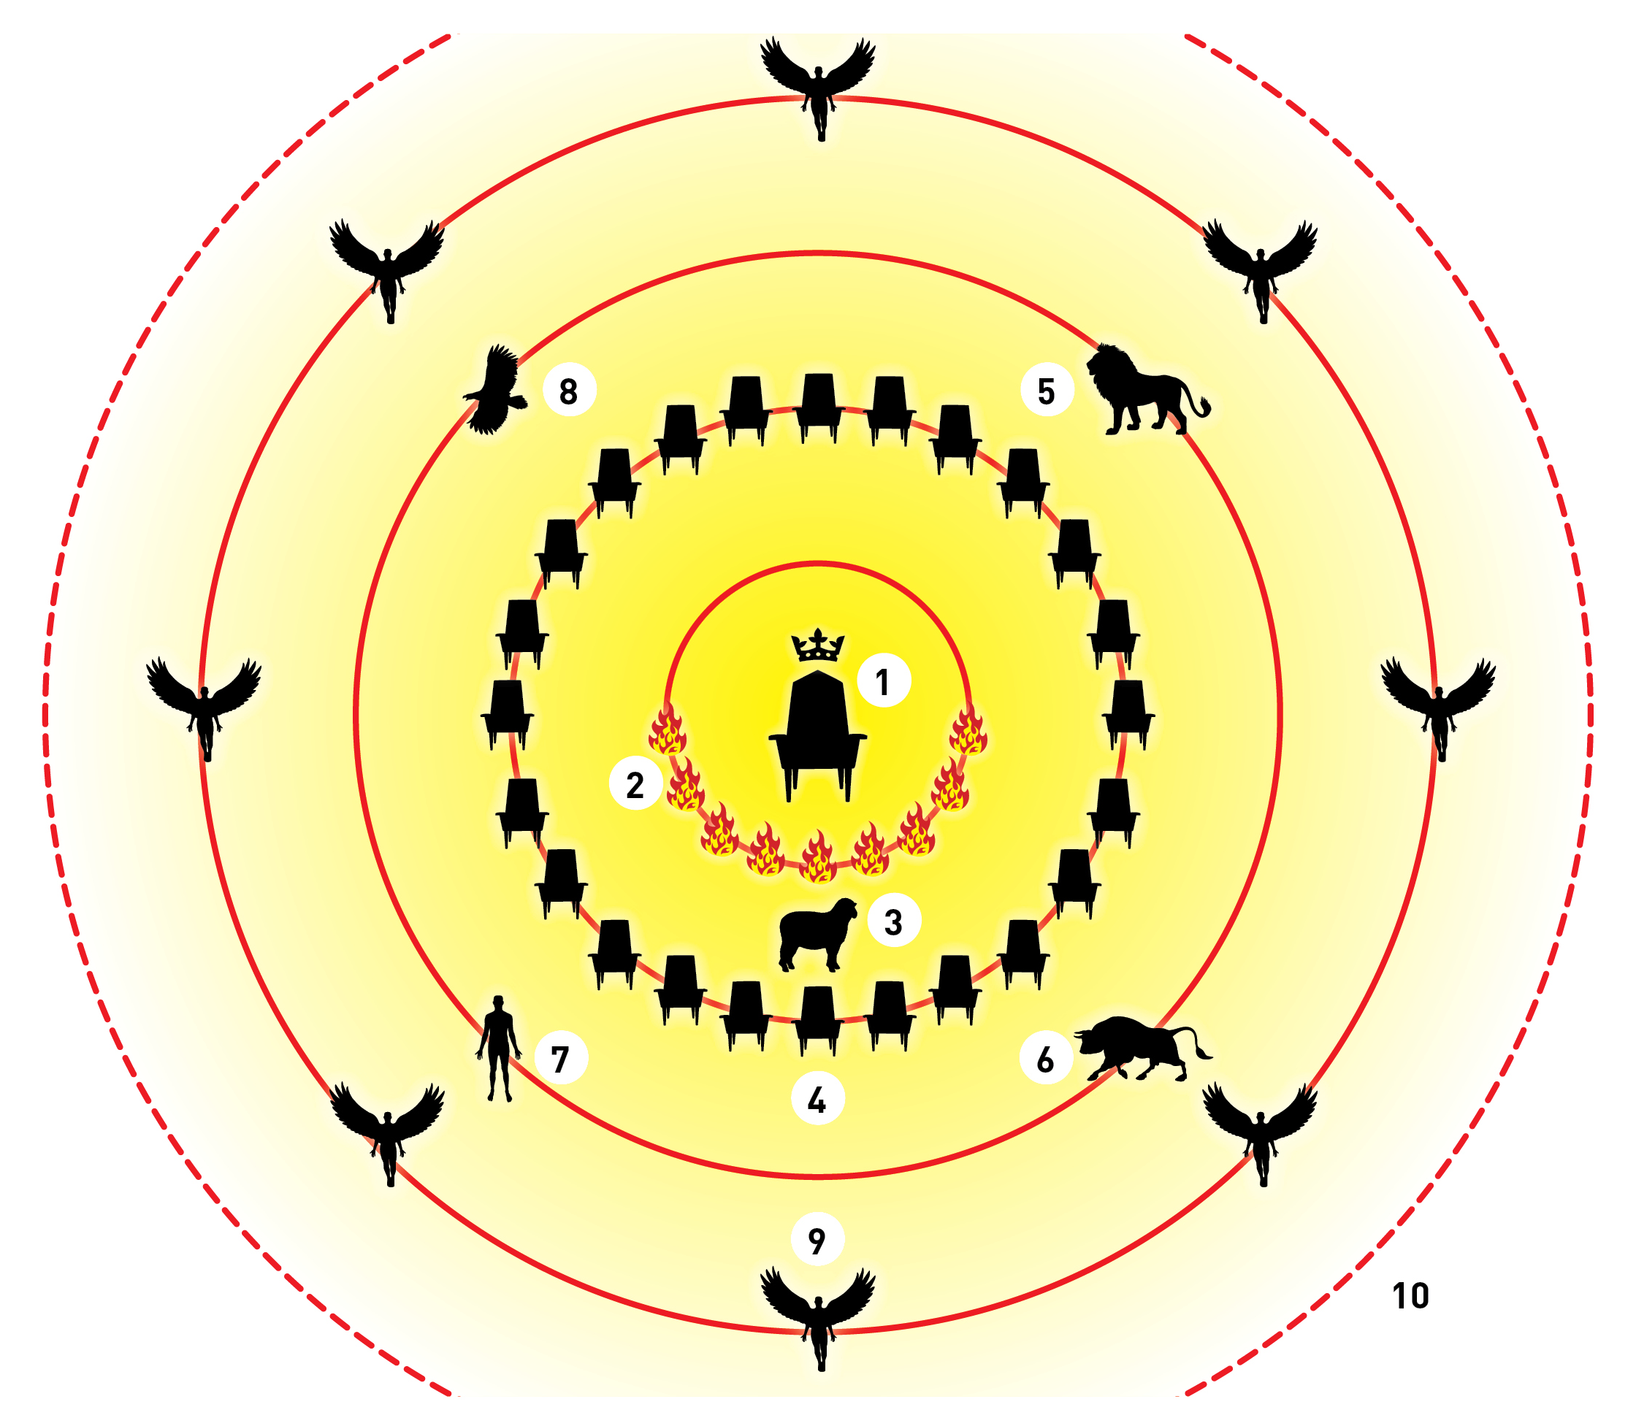
What John saw…
Throne
Lamps/spirits
The lamb
24 Elders
5 – 8. The 4 ‘creatures’
9. Thousands of angels
10. Every creature!

Slide 7
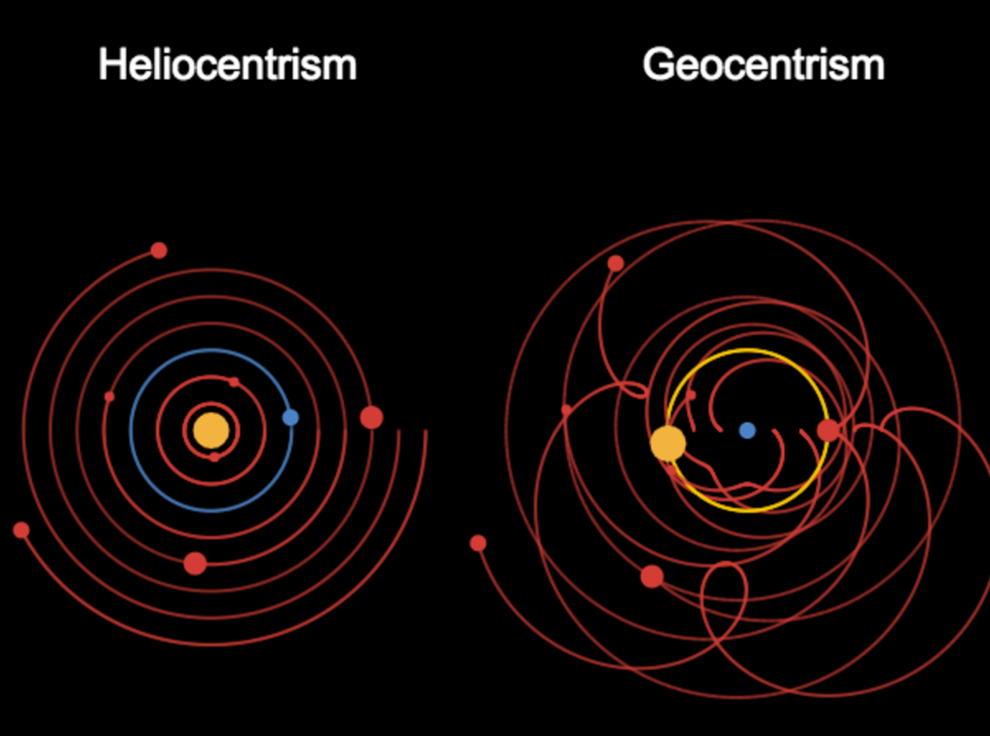
Theo-centric view of the universe. . .

Slide 8
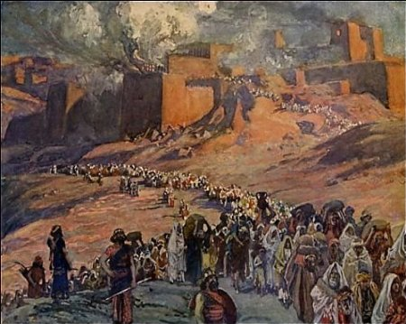
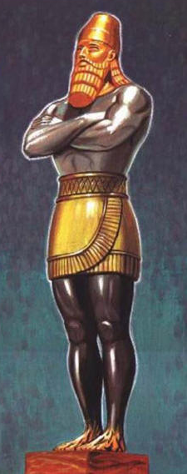
Visions – Why?
Ezekiel
Destruction of Jerusalem
End of temple worship
Beginning of Daniel 2 image

Slide 9
Visions – Why?
Revelation
Exile (of believers)
Destruction of Jerusalem
End of temple worship
Beginning of Christian era
In context – transition from ‘present’ (messages to churches) to ‘future’ seals, trumpets, beasts etc

Slide 10
Visions – Why?
Ezekiel
Exile
Destruction of Jerusalem
End of temple worship
Beginning of Daniel 2 image
Revelation
Exile (of believers)
Destruction of Jerusalem
End of temple worship
Beginning of Christian era
In context – transition from ‘present’ (messages to churches) to ‘future’ seals, trumpets, beasts etc

Slide 11
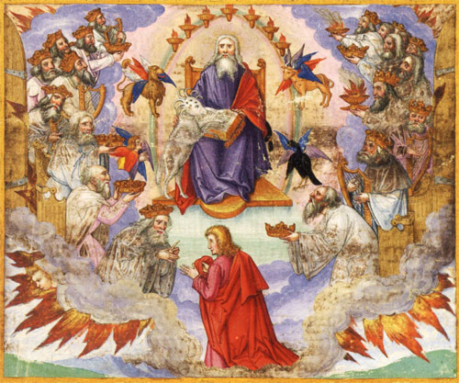
Theo-centric. . .
God’s throne at the centre
God in charge
Of Everything?
Political?
National?
Moral?
Personal?

Slide 12
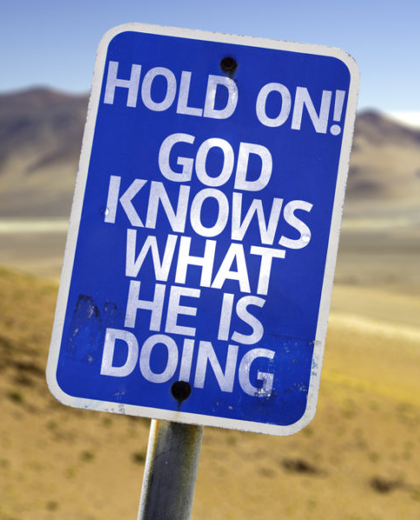
Key question . . .
Do we trust God?
What do we mean by ‘trust’?
To acknowledge that God knows best
To accept that He wants what is best
To appreciate His guidance
The MOST challenging thing a Christian does

Slide 13
The Ladder of Trust. . .
Rung 1 – Trusting means Obeying

Slide 14
The Ladder of Trust. . .
Rung 1 – Trusting means Obeying
Trust in the Lord with all your heart and lean not on your own understanding; in all your ways submit to him, and he will make your paths straight.
Proverbs 3: 5-6

Slide 15
The Ladder of Trust. . .
Rung 1 – Trusting means Obeying
Do not merely listen to the word, and so deceive yourselves. Do what it says.
James 1: 22

Slide 16
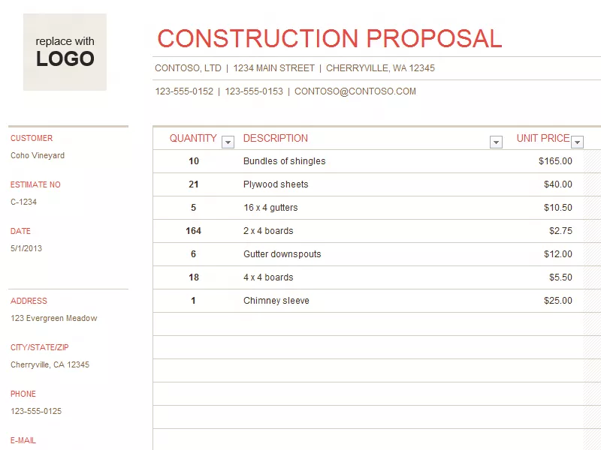
The Ladder of Trust. . .
Rung 1 – Trusting means Obeying
Example:

Slide 17
The Ladder of Trust. . .
Rung 1 – Trusting means Obeying
Why NOT trust?
I know better
My situation is different
I ‘feel’ . . .
Obedience will cost me!
I’m not sure God has my best interests at heart

Slide 18
The Ladder of Trust. . .
Rung 2 – Trusting that God will provide
²⁵ “Therefore I tell you, do not worry about your life, what you will eat or drink; or about your body, what you will wear. Is not life more than food, and the body more than clothes?
³³ But seek first his kingdom and his righteousness, and all these things will be given to you as well.
Matthew 6: 25 & 33

Slide 19
The Ladder of Trust. . .
Rung 2 – Trusting that God will provide
And my God will meet all your needs according to the riches of his glory in Christ Jesus.
Philippians 4: 19

Slide 20
The Ladder of Trust. . .
Rung 2 – Trusting that God will provide
God loves us – so wants the best for us
God provides – offsets any ‘disadvantage’
God understands – he knows us

Slide 21
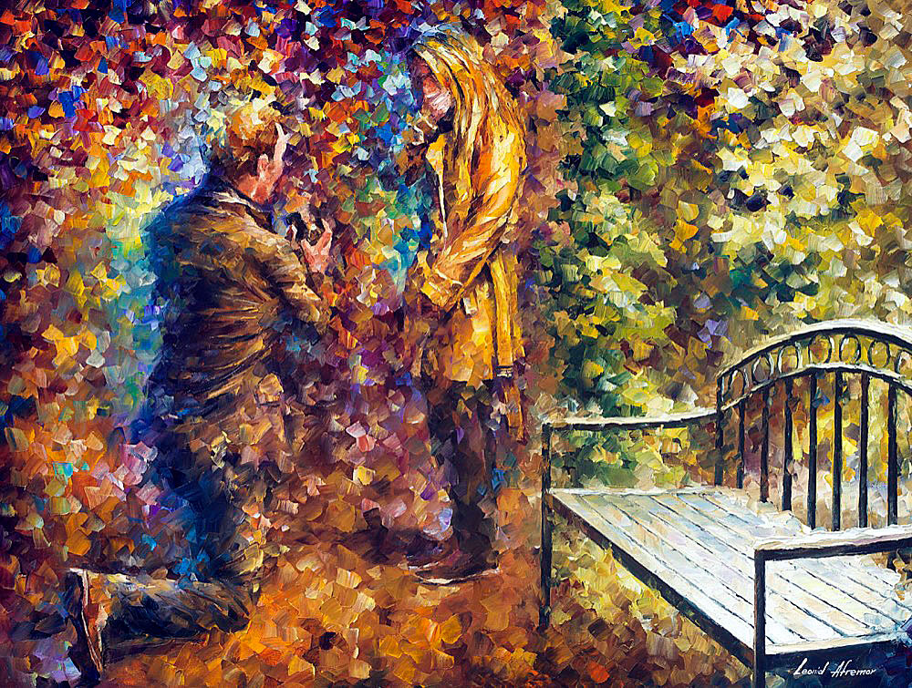
The Ladder of Trust. . .
Rung 2 – Trusting that God will provide
Personal experience!
Notes:
2 Cor 6:14 – do not be unequally yoked together with unbelievers
Deut 7:3 – Do not give your daughters to their sons. . .
Amos 3:3 – can two walk together unless they be in agreement?

Slide 22
The Ladder of Trust. . .
Summary
Obedience / Trust are synonymous
God provides for his children
when they seek first the Kingdom of Heaven!

